Slide 1




Basketball IV
Produced by Dr. Mario
UNC STOR 538

Slide 2
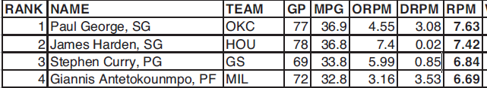
NBA Salaries
Recall Baseball Salary Estimation
Based on WAR in Baseball
Assumed Replacement Player Costs $500,000
Team of Replacement Players Cost $12.5M (48-114 Record)
Average Team’s Salary was $114M (81-81 Record)
$101.5M Needed for Replacement Team to Get to Average
Real Plus-Minus (RPM)
Designed by Jermias Engelmann and Steve Ilardi
Utilized Modified Ridge Regression to Shrink Coefficients Toward the Box Plus-Minus of the Player
Leaders in 2018-2019

Slide 3

NBA Salaries
Interpretation of RPM
Numbers are Per 100 Possessions
Giannis RPM = 6.69
If Giannis Replaced an Average Player, then his Team Improves by 6.69 Points Over the Opponent Per 100 Possessions
RPM of an Average Player = 0
RPM of a Replacement Player = -3.1 (Equivalent to 10 Percentile)
Team of Replacement Players
Deficit Versus an Average Team
Average Pace in 2017-2018 = 96 Possessions Per Game
Conversion of Deficit Per 100 Possessions to Per Game
$$5\left(−3.1\right)=−15.5 Points Per 100 Possessions$$
$$\left(−\frac{15.5}{100}\right)∗96=−14.88 Points Per Game$$

Slide 4



NBA Salaries
Replacement Team Versus Average Team
Average Team Scored 105.6 Points Per Game
Expected Final Score: 90.72 to 105.6 (Difference of 14.88)
Scoring Ratio
Basketball Pythagorean Theorem From Chapter 1 ($α=14$)
Conclusion: Expect Replacement Team to Win 10.7% of Games
$$\frac{90.72}{105.6}=0.86$$
$$\frac{{0.86}^{14}}{{0.86}^{14}+1}=10.7\%$$
$$Final Record=8.7 Wins and 73.3 Losses$$

Slide 5
NBA Salaries
Application to NBA Salaries (Based off 2017-2018)
Average Team Payroll Was Approximately $93M
Minimum Player Salary Between $500K and $1.5M
Assume Average Minimum= $1M
Payroll of Replacement Team = $12M
Costs $93M - $12M = $81M to Go From Replacement to Average
This is Equivalent to Go From 9 Wins to 41 Wins
Equivalent:
For Simplicity/Laziness,
Each Win Above Replacement is Worth $2.5 Million
$$32 Wins=\$81M$$
$$32 Wins=\$80M$$

Slide 6
NBA Salaries
Calculation of Fair Salary
Suppose Player Generated 20 Wins in 2016-2017
Descriptive Versus Predictive Metrics
Book Calculates Fair Salary of a Player in 2018 Based off Generated Wins From Previous Season
What is the Problem Here?
$$Fair Salary=20∗2.5=\$50M$$
 | Player Wins This Year | Player Wins Next Year
Team Salaries This Year | Fair Pay in Previous Year | Not Helpful?
Team Salaries Next Year | Determining Fair Salary | Fair Pay in Next Year

Slide 7
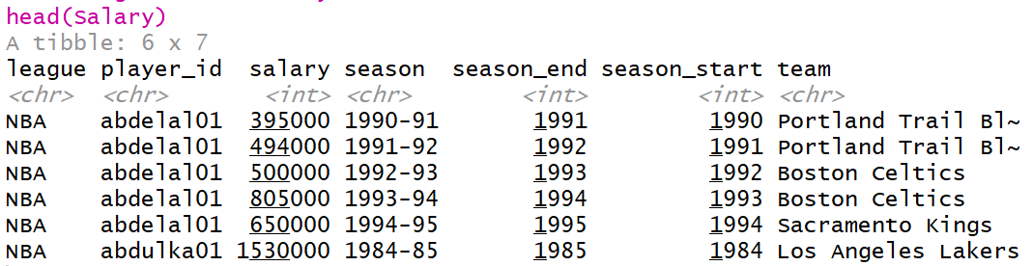
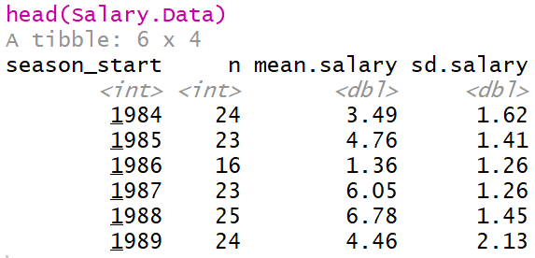
NBA Salaries
NBA Salary Information Across the Years
Data from Basketball-Reference.com
Data Preview
Salary Summarized by Season

Slide 8
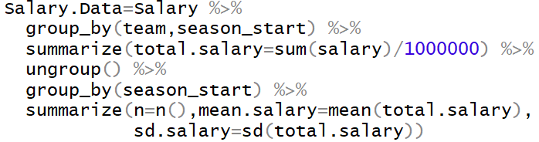
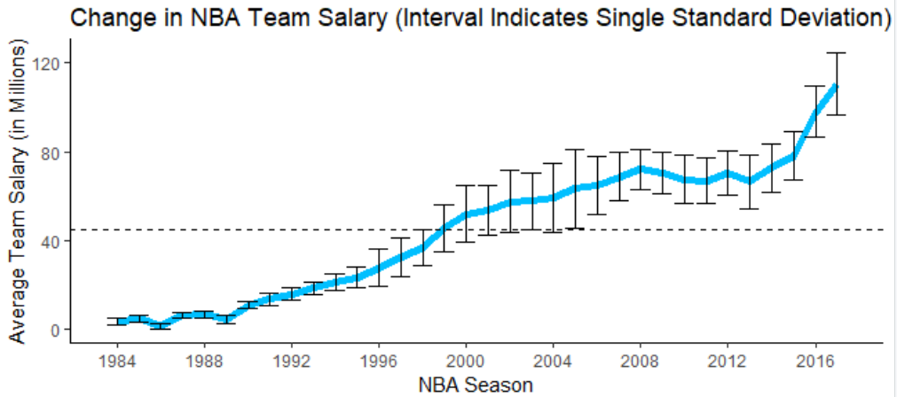
NBA Salaries
NBA Salary Information Across the Years
Code for Summary Table
Figure Showing Change
Textbook

Slide 9
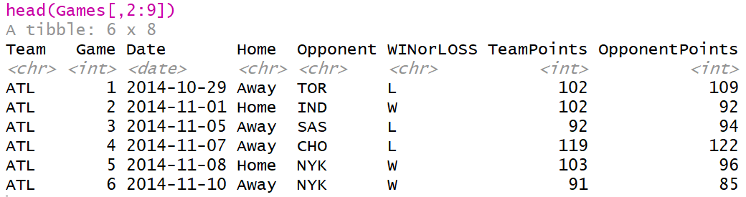

NBA Salaries
Pythagorean Theorem For Basketball
Modeling Win Percentage Using Points
From Textbook, α=14 Based on Data
Question: Can We Confirm This?
Data from 2014 to 2018 Found on Kaggle
$$Win \%≈\frac{{\left(\frac{Points Scored}{Points Allowed}\right)}^{α}}{{\left(\frac{Points Scored}{Points Allowed}\right)}^{α}+1}$$

Slide 10
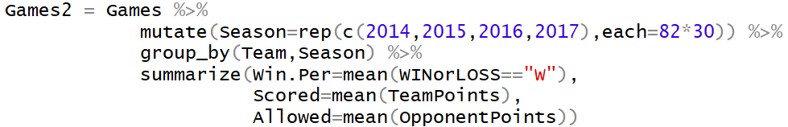
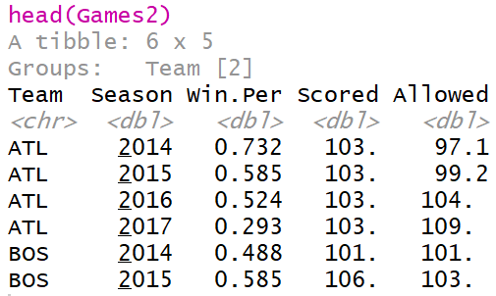
NBA Salaries
Pythagorean Theorem For Basketball
Modifying Data for Estimating α

Slide 11
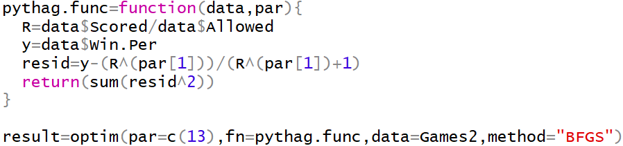

NBA Salaries
Pythagorean Theorem For Basketball
Minimize Sum of Squares (Predicted Win % Versus Actual Win %)
Based on Recent Data, Best α is 14.4564

Slide 12
NBA Salaries
Cost of Winning (Based on Book)
Cost $12M to Get 9 Wins Over 82 Games
$12M is $81M Less Than the Average Salary (2017-2018)
Assumption: Costs $81M to Be Average
This Implies:
Criticism 1
Team Salaries are Highly Skewed and Influenced by Outliers
Recommendation: Use Median
Criticism 2
Average Salary may not be the Salary of an Average Team
Recommendation: Regress Salary on Wins and Predict When Wins = 41
$$Price Per Win=\frac{\$81M}{41−9}=\$2.5M$$

Slide 13
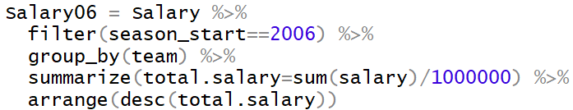
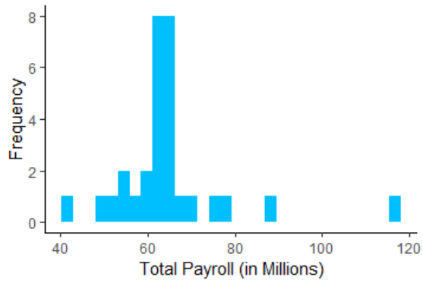
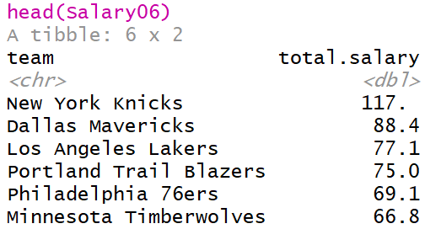
NBA Salaries
Observe Interesting Data From 2006
Team: New York Knicks
Payroll: $117M
Record: 33-49
Conclusion: Idiots

Slide 14
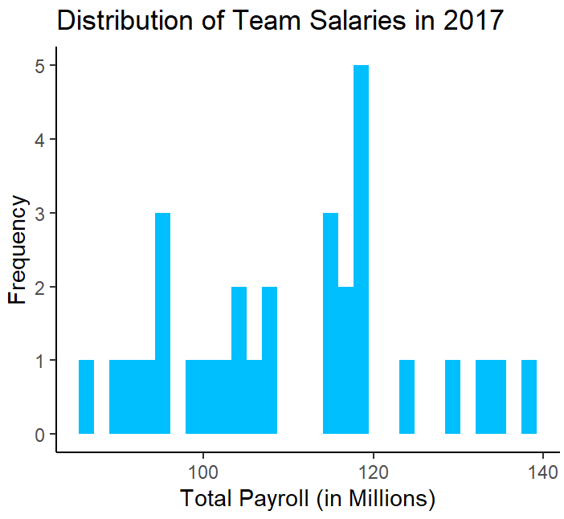
NBA Salaries
Fix Based on Criticism 1
2017-2018 Season
Average Salary: $110M
Fix
Median Salary: $111M

Slide 15
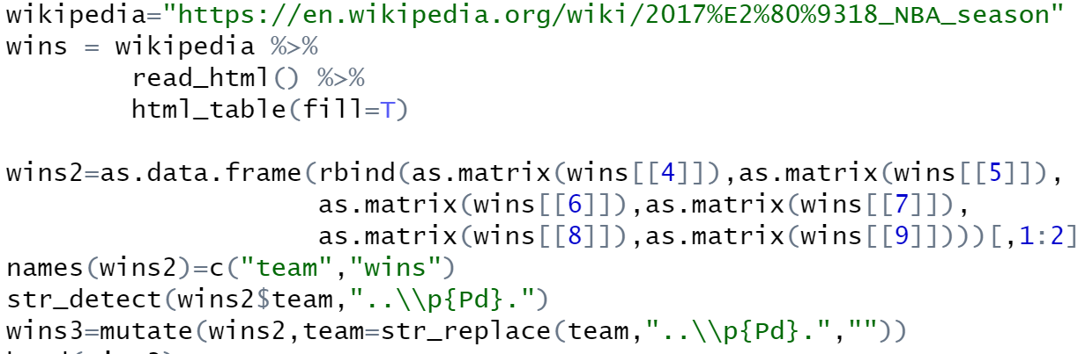
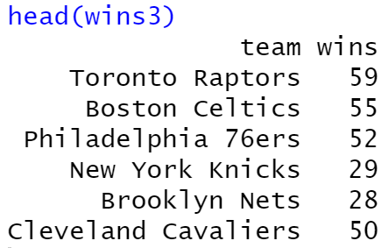
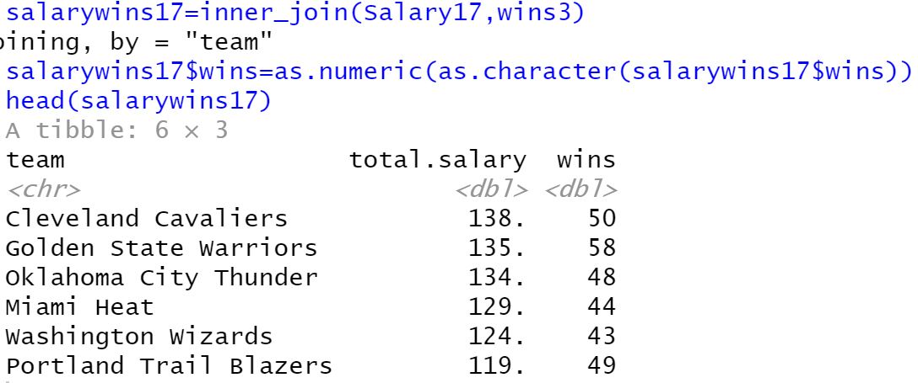
NBA Salaries
Getting Wins and Losses Into Data
Scraping Team Records From Wikipedia
Merging Datasets

Slide 16
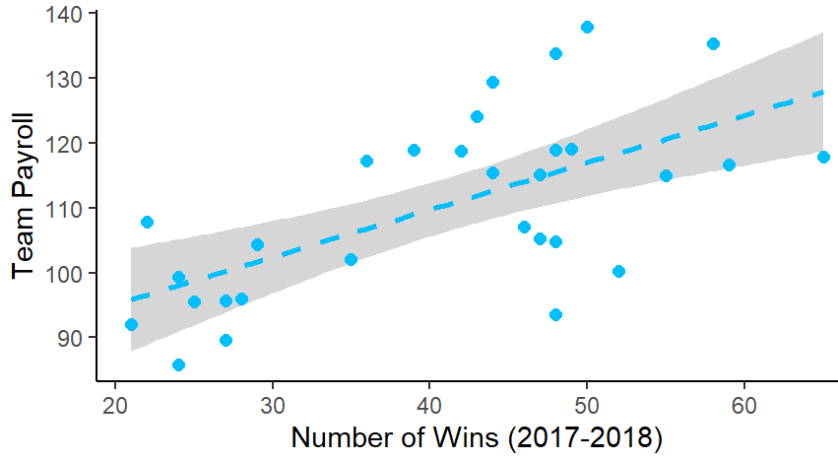
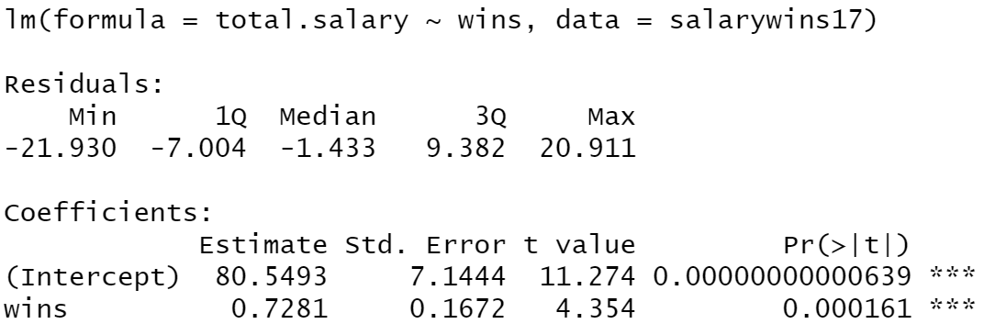
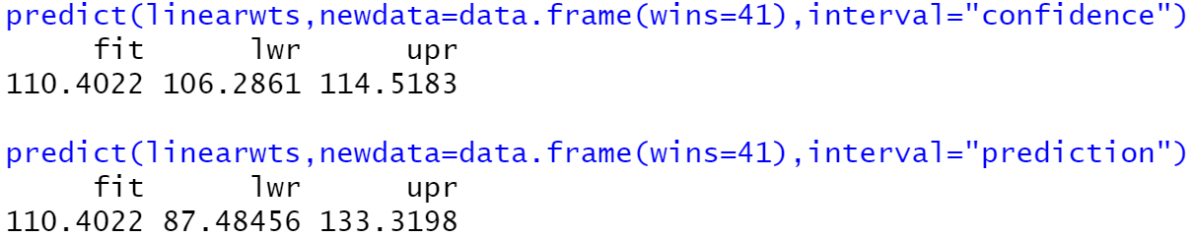
NBA Salaries
Fix Based on Criticism 2
Linear Regression Model and Fit
Prediction for 41 Wins is Almost Identical to Actual Average Salary
What is the Value of Knowing the Lower and Upper Limits?

Slide 17

Final Inspiration
There is no “I” in team,
but there is in win.
- Michael Jordan

